Slide 1

Integrated System for Acquisition of Biological Signals
Applied Computing Graduate Program
Internet of Things and Distributed Systems
William da Rosa Fröhlich

Slide 2


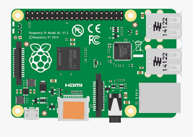


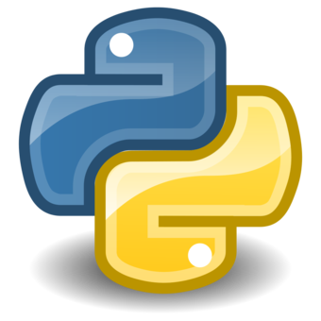
BITalino Raspberry Pi
Acquisition
Port: 18002
Processing
Applied Computing Graduate Program
Internet of Things and Distributed Systems

Slide 3
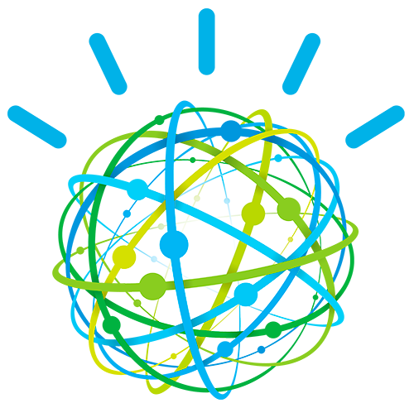



System
Cloud
Dashboard
Processing
Acquisition
Database
Dashboard
Applied Computing Graduate Program
Internet of Things and Distributed Systems

Slide 4
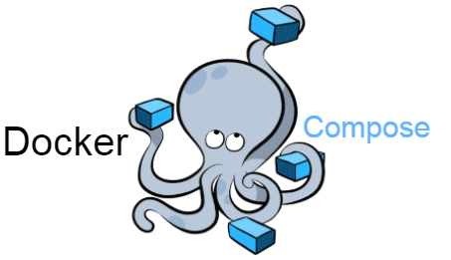
Docker
Processing
Acquisition
Database
Dashboard
Applied Computing Graduate Program
Internet of Things and Distributed Systems

Slide 5

Cloud
Cloud
Dashboard
Processing
Acquisition
Applied Computing Graduate Program
Internet of Things and Distributed Systems

Slide 6
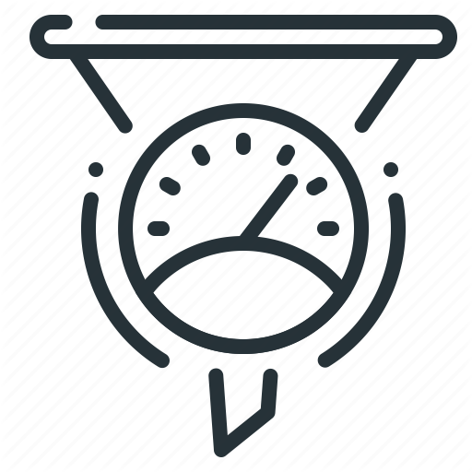


Metrics
Acquisition Amount of Data Cost
Sampling – 10 Hz
5 Minutes – Raw Data – 3,000
– Processed – 65
1 Hour – Raw Data – 36,000
– Processed – 780
Database:
5 Minutes – 19 KB
1 Hour – 143 KB
Cloud:
Each Event: 0.1 MB
Free:
500 Devices
500 Application
200 MB each of data
2,500.00 USD:
5000 Devices
1,000,000 Events
Applied Computing Graduate Program
Internet of Things and Distributed Systems

Slide 7

Thank you!

